Slide 1
EE450: High Voltage Engineering
Lecture 2

Slide 2
Outline
Overvoltages in Power Systems
Introduction
Lightning overvoltages
Lightning discharge
Lightning voltage surge
Switching overvoltages
Origin of switching overvoltages
Energization of an unloaded transmission line
Temporary overvoltages
Ferranti effect
Load rejection
Ground fault
Harmonic overvoltages due to magnetic saturation
Page 2

Slide 3
Introduction
In normal operation, AC (or DC) voltages do not severely stress the insulation of the power system.
Overvoltages stressing a power system are classified into two categories:
External overvoltages: generated by atmospheric disturbances such as lightning phenomenon.
Internal overvoltages: generated by changes in the operating conditions of the network.
Internal overvoltages can be further divided into:
Switching overvoltages
Temporary overvoltages
Page 3

Slide 4
Introduction
Lightning and switching operations produce a sudden rise in voltage for a very short duration, known as a voltage surge or transient voltage.
The magnitude of these overvoltages is sufficiently high to cause insulation breakdown of the equipment in power systems.
Therefore, power system engineers always device ways to limit the magnitude of the overvoltages and to control their effects on the operating equipment.
Page 4

Slide 5
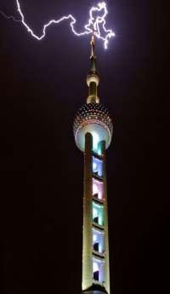
Lightning Overvoltages
Lightning is an electrical discharge between cloud and earth, between clouds, or between the charge centres of the same cloud.
Lightning is a huge spark and takes place when clouds are charged to such a high potential (+ve or
−ve) with respect to earth or a neighbouring cloud that the dielectric strength of neighbouring medium (air) is destroyed.
For breakdown of air at STP condition, the electric field required is 30 kV/cm peak.
Page 5

Slide 6
Lightning Overvoltages
However, in a cloud where the moisture content in the air is large and also because of the high altitude (lower pressure), it is seen that for breakdown of air, the electric field required is only 10 kV/cm.
The cloud and the ground form two plates of a gigantic capacitor and the dielectric medium is air.
During thunderstorms, positive and negative charges are separated by the movements of air currents forming ice crystals in the upper layer of a cloud and rain in the lower part.
The cloud becomes negatively charged and has a larger layer of positive charge at its top.
Page 6

Slide 7
Lightning Overvoltages
As the separation of charge proceeds in the cloud, the potential difference between the concentrations of charges increases and the vertical electric field along the cloud also increases.
The total potential difference between the two main charge centers may vary from 100 to 1000 MV.
Only a part of the total charge-several hundred coulombs-is released to earth by lightning; the rest is consumed in intercloud discharges.
The height of the thundercloud dipole above earth may reach 5 km in tropical regions.
Page 7

Slide 8
Lightning Discharge
When a gradient of approximately 10 kV/cm is set up in the cloud, the air surrounding the cloud gets ionized.
At this stage, a lightning discharge occurs through the air in the form of streamer breakdown of long air gaps from the cloud towards the earth.
The channel to earth is first established by a stepped discharge called a leader stroke.
The leader is generally initiated by a breakdown between polarized water droplets at the cloud base caused by the high electric field, or a discharge between the negative charge mass in the lower cloud and the positive charge pocket below it.
As the downward leader approaches the earth, an upward leader begins to proceed from earth before the former reaches earth.
Page 8

Slide 9
Lightning Discharge
The upward leader joins the downward one at a point referred to as the striking point.
This is the start of the return stroke, which progresses upward like a traveling wave on a transmission line.
At the earthing point, a heavy impulse current reaching the order of tens of kiloamperes occurs, which is responsible for the known damage of lightning.
The velocity of progression of the return stoke is very high and may reach half the speed of light.
The corresponding current heats its path to temperatures up to 20, 000ºC, causing the explosive air expansion that is heard as thunder.
The current pulse rises to its crest in a few microseconds and decays over a period of tens or hundreds of microsecond.
Page 9

Slide 10
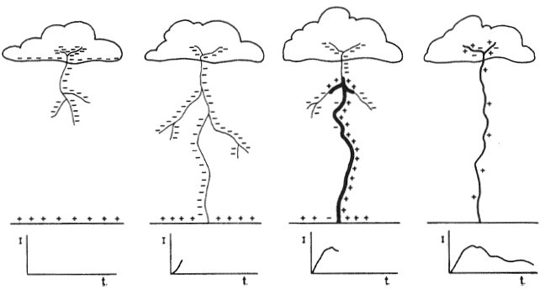
Lightning Discharge
Development stages of a lightning flash and the corresponding surge current
Page 10

Slide 11
Lightning Discharge
Characteristics of lightning current are:
Lightning current is unipolar and does not oscillate around current zero
Peak amplitude of current (in the range of 10 kA to 100 kA)
Rate of rise of current (7.5 - 25 kA/μs)
Characteristics of lightning overvoltage are:
Voltage waveform (1000-5000 kV, 1 MV/μs)
Front time of the voltage varies between 2–10 μs
Tail time varies from 20–100 μs
Page 11

Slide 12
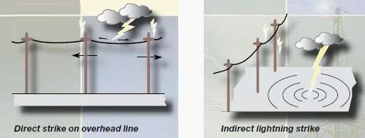
Lightning Discharge
Lightning may interact with overhead lines in two ways:
Direct stroke
Indirect stroke (lightning stroke reaches the ground near the line)
Page 12

Slide 13
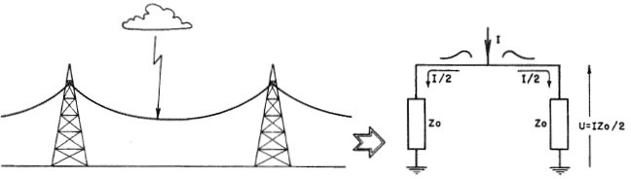
Lightning Voltage Surge
The most severe lightning stroke is that which strikes a phase conductor on the transmission line as it produces the highest overvoltage for a given stroke current.
If lightning hits one of the phase conductors, the return-stroke current splits into two equal halves, each half travelling in either direction of the line.
The travelling current waves produce travelling voltage waves.
Development of a lightning overvoltage
Page 13

Slide 14
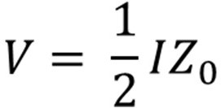
Lightning Voltage Surge
Therefore, the voltage surge magnitude at the striking point is,
where I is the return-stroke current, Z₀ is the surge impedance of the line given
by Z₀ = (L/C)^{1/2}, and L and C are the series inductance and capacitance to ground per meter length of the line.
If a lightning stroke current (I) of 10,000 A strikes a line of 400 Ω surge impedance (Z₀), it may cause an overvoltage of 4000 kV.
In case a direct stroke occurs, the current wave would divide into two branches and travel on either side of the line.
Page 14

Slide 15
Lightning Voltage Surge
Hence, the effective surge impedance of the line as seen by the wave is Z₀/2 and the overvoltage caused would be 10,000 x (400/2) = 2000 kV.
If this line were to be a 132 kV line with an eleven disc-type insulator string, the flashover of the insulator string will take place, as the impulse flashover voltage of the string is about 950 kV for a 2 µs front impulse wave.
The insulation of high voltage equipment may experience a break down under the resulting overvoltage and the subsequent high-energy discharge.
Page 15

Slide 16
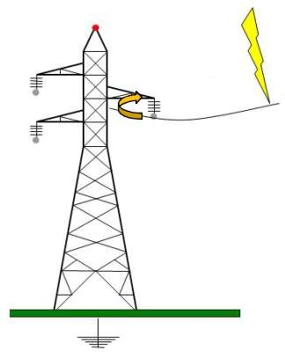
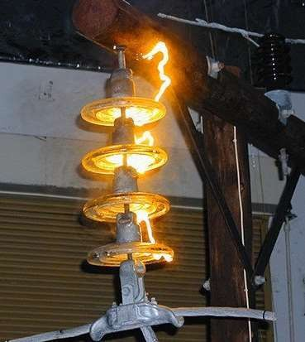
Lightning Voltage Surge
Page 16

Slide 17
Switching Overvoltages
The opening and closing of circuits due to frequent switching operations may give rise to overvoltage transients in a power system.
Switching operations will generate an overvoltage up to 2-3 times the normal voltage.
With an increase in the transmission voltages to increase the transmitted power, switching surges have become the governing factor in the design of insulation for EHV and UHV systems.
In the meantime, lightning overvoltages come as a secondary factor in these networks.
Page 17

Slide 18
Switching Overvoltages
There are two fundamental reasons for this shift in relative importance from lightning to switching surges as higher transmission voltages are called for:
Overvoltages produced on transmission lines by lightning strokes are only slightly dependent on the power system voltages. As a result, their magnitudes relative to the system peak voltage decrease as the latter is increased
External insulation has its lowest breakdown strength under surges whose fronts fall in the range 50- 500 µs, which is typical for switching surges
According to the International Electrotechnical Commission (IEC) recommendations, all equipment designed for operating voltages above 300 kV should be tested under switching impulses (i.e., laboratory-simulated switching surges).
Page 18

Slide 19
Origin of Switching Overvoltages
There are several events that would initiate a switching surge in a power network.
The switching operations of greatest relevance to insulation design can be classified as follows:
Energization of transmission lines and cables: The following specific switching operations are some of the most common in this category:
Energization of a line that is open circuited at the far end
Energization of a line that is terminated by an unloaded transformer
Energization of a line through the low-side side of transformer
Re-energization of a line: This means the energization of a transmission line carrying charges trapped by previous line interruptions when high-speed reclosures are used.
Page 19

Slide 20
Origin of Switching Overvoltages
Load rejection: This is caused by a circuit breaker opening at the far end of the line. This may also be followed by opening the line at the sending end in what is called a line dropping operation.
Switching on and off of equipment: All switching operations involving an element of the transmission network will produce a switching surge. For example:
Switching of high-voltage reactors
Switching of transformers that are loaded by a reactor on their tertiary winding
Switching of a transformer at no load
Fault initiation and clearing
Page 20

Slide 21
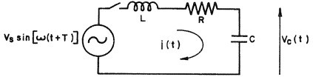

Energization of an Unloaded Transmission Line
Suppose that the sinusoidal supply voltage is switched on to an unloaded transmission line as shown in Figure.
R, L and C represents the total series resistance, inductance and capacitance to ground from source up to the far end of line including the transformer.
The switching operation is performed at an instant T seconds beyond that of zero voltage.
The voltage across the capacitor C is the one under study here, as it represents the voltage at the open-circuit end of the line.

Slide 22

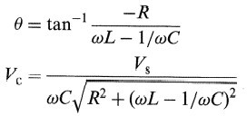
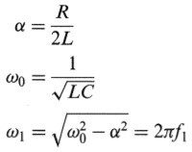
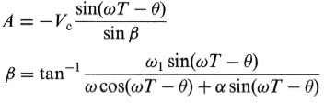
Energization of an Unloaded Transmission Line
The sinusoidal supply voltage v_{s} (t) is given by,
Applying KVL around the closed loop,
The expression for the voltage across the line capacitance takes the form:

Slide 23
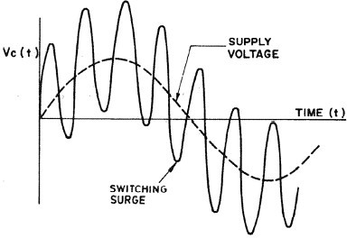
Energization of an Unloaded Transmission Line
Energization switching transient

Slide 24
Standardization of Testing Voltage Waveforms
In practice, the shape and magnitudes of lightning and switching overvoltage waveform differs with every event.
However, field measurements have shown that lightning and switching overvoltages are characterized by short front duration, and then slowly decreasing to zero.
The standard lightning impulse voltage has been accepted as an aperiodic impulse that reaches its peak value in 1.2 µsec and then decreases slowly (in about 50 µsec) to half its peak value.
The standard switching impulse voltage has been accepted as an aperiodic impulse that reaches its peak value in 250 µsec and then decreases slowly (in about 2500 µsec) to half its peak value.

Slide 25
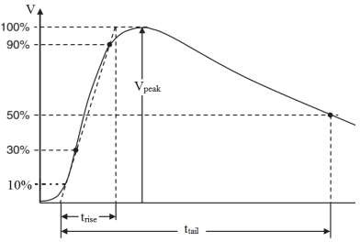
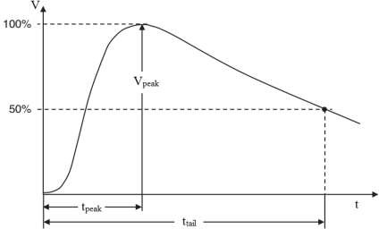
Standardization of Testing Voltage Waveforms
General waveshape of lightning impulse voltage (1.2/50 µs)
General waveshape of switching impulse voltage (250/2500 µs)

Slide 26
Temporary Overvoltages
Temporary overvoltages (i.e., sustained overvoltages) differ from transient switching overvoltages in that they last for longer durations, typically from a few cycles to a few seconds.
They take the form of undamped or slightly damped oscillations at a frequency equal or close to the power frequency.
Some of the most important events leading to the generation of temporary overvoltages are:
Ferranti effect
Load rejection
Ground fault
Harmonic overvoltages due to magnetic saturation

Slide 27

Ferranti Effect
The receiving-end voltage of an uncompensated transmission line is given by,
where V_{r} and V_{s} are the receiving-end and sending-end voltages, respectively,
l is the line length (km)
β₀ is the phase shift constant of the line per unit length. It is equal to the imaginary part of sqrt (ZY), where Z and Y are the impedance and admittance of the line per unit length.
For a lossless line , β₀ = ω sqrt (LC), where L and C are the inductance and capacitance of the line per unit length.

Slide 28
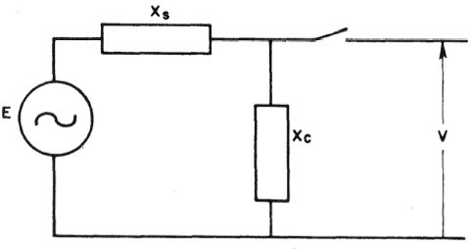
Load Rejection
When a transmission line or a large inductive load that is fed from a power station is suddenly switched off, the generator will speed up and the busbar voltage will rise.
The equivalent network is shown as:
Equivalent circuit during load rejection

Slide 29

Load Rejection
The amplitude of the overvoltage can be evaluated approximately by,
E is the voltage behind the transient reactance, which is assumed to be constant over the subtransient period and equal to its value before the incident
X_{s} the transient reactance of the generator in series with the transformer reactance
X_{c} the equivalent capacitive input reactance of the system
where

Slide 30
Ground Fault
A single line-to-ground fault will cause the voltages to ground of the healthy phases to rise.
In the case of a line-to-ground fault, systems with neutrals isolated or grounded through a high impedance may develop overvoltages on healthy phases higher than normal line-to-line voltages.
Solidly grounded systems, on the other hand, will only permit phase-to-ground overvoltages well below the line-to-line value.
An earth fault factor is defined as the ratio of the higher of the two sound phase voltages to the line-to-neutral voltage at the same point in the system with the fault removed.
Page 30

Slide 31
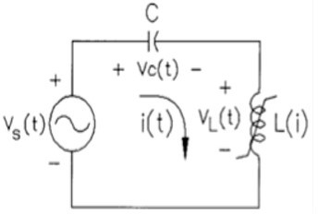
Harmonic Overvoltages due to Magnetic Saturation
Ferroresonance is a resonance phenomenon caused by the nonlinear inductance and system capacitance.
Harmonic oscillations in power systems are initiated by system nonlinearities whose primary source is that of the saturated magnetizing characteristics of transformers and shunt reactors.

Slide 32
Harmonic Overvoltages due to Magnetic Saturation
The magnetizing current of these components increases rapidly and contains a high percentage of harmonics for voltages above the rated voltage.
Therefore, saturated transformers inject large harmonic currents into the system.

Slide 33
THANK YOU FOR YOUR ATTENTION

